Slide 1
Human Activity Recognition
Edwin Candinegara

Slide 2
Objectives
Real-time Smartphone based Human Activity Recognition
Smartwatch based Human Activity Recognition
Notes:
= Data collection process → documentation
= Activity description
Versus available data currentls

Slide 3
Data Collection
7 persons – including myself (4 males, 3 females, 19-22 years old)
Collected Data Summary:
15 activities / person
Number of Minutes:
Edwin: 89 mins
Richsen: 90 mins
Lauren: 45 mins
Shelina: 45 mins
Mellita: 45 mins
Nikolas: 45 mins
Samuel: 45 mins
TOTAL: 402.5 mins

Slide 4
Baseline Results

Slide 5
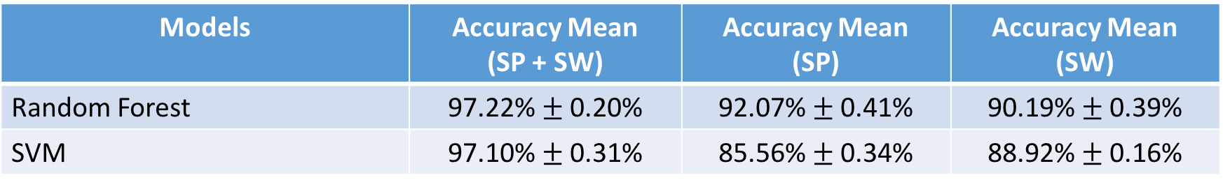
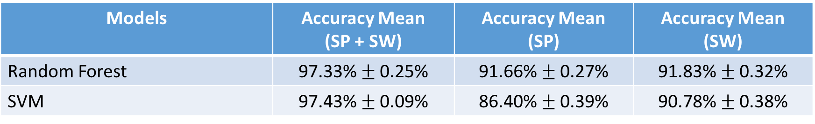
5-Fold CV on Combined Dataset (6 persons)
15 activities, Sampling @ 10 Hz, Window Size = 2s
14 activities (WITHOUT EATING), Sampling @ 10 Hz, Window Size = 2s
Models | Accuracy Mean (SP + SW) | Accuracy Mean (SP) | Accuracy Mean (SW)
Random Forest | 97.22% $±$ 0.20% | 92.07% $±$ 0.41% | 90.19% $±$ 0.39%
SVM | 97.10% $±$ 0.31% | 85.56% $±$ 0.34% | 88.92% $±$ 0.16%
Models | Accuracy Mean (SP + SW) | Accuracy Mean (SP) | Accuracy Mean (SW)
Random Forest | 97.33% $±$ 0.25% | 91.66% $±$ 0.27% | 91.83% $±$ 0.32%
SVM | 97.43% $±$ 0.09% | 86.40% $±$ 0.39% | 90.78% $±$ 0.38%

Slide 6
7 Persons Results

Slide 7
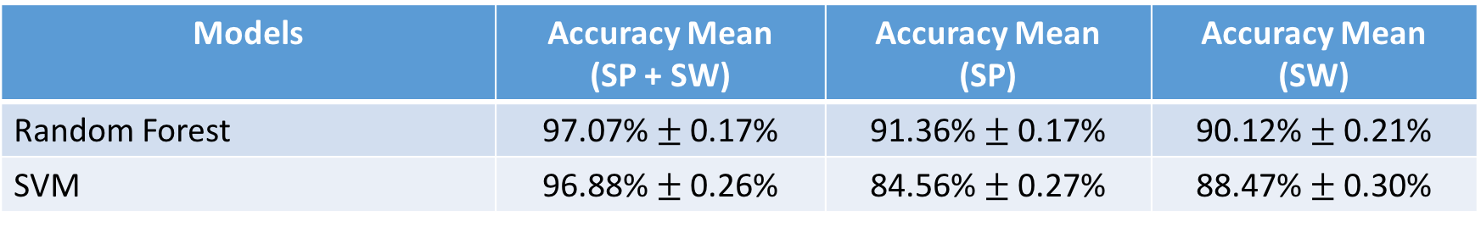
5-Fold CV on Combined Dataset (7 persons)
15 activities, Sampling @ 10 Hz, Window size = 2s
Comparison → 15 activities, 6 Persons results:
Models | Accuracy Mean (SP + SW) | Accuracy Mean (SP) | Accuracy Mean (SW)
Random Forest | 97.07% $±$ 0.17% | 91.36% $±$ 0.17% | 90.12% $±$ 0.21%
SVM | 96.88% $±$ 0.26% | 84.56% $±$ 0.27% | 88.47% $±$ 0.30%
Models | Accuracy Mean (SP + SW) | Accuracy Mean (SP) | Accuracy Mean (SW)
Random Forest | 97.22% $±$ 0.20% | 92.07% $±$ 0.41% | 90.19% $±$ 0.39%
SVM | 97.10% $±$ 0.31% | 85.56% $±$ 0.34% | 88.92% $±$ 0.16%

Slide 8
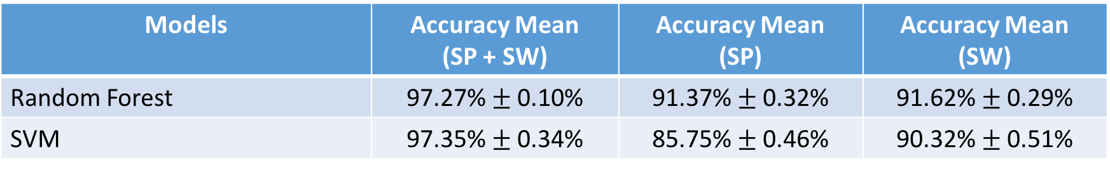
5-Fold CV on Combined Dataset (7 persons)
14 activities (WITHOUT EATING), Sampling @ 10 Hz, Window size = 2s
Comparison → 14 activities (WITHOUT EATING), 6 Persons results:
Models | Accuracy Mean (SP + SW) | Accuracy Mean (SP) | Accuracy Mean (SW)
Random Forest | 97.27% $±$ 0.10% | 91.37% $±$ 0.32% | 91.62% $±$ 0.29%
SVM | 97.35% $±$ 0.34% | 85.75% $±$ 0.46% | 90.32% $±$ 0.51%
Models | Accuracy Mean (SP + SW) | Accuracy Mean (SP) | Accuracy Mean (SW)
Random Forest | 97.33% $±$ 0.25% | 91.66% $±$ 0.27% | 91.83% $±$ 0.32%
SVM | 97.43% $±$ 0.09% | 86.40% $±$ 0.39% | 90.78% $±$ 0.38%

Slide 9
Leave One Out CV

Slide 10
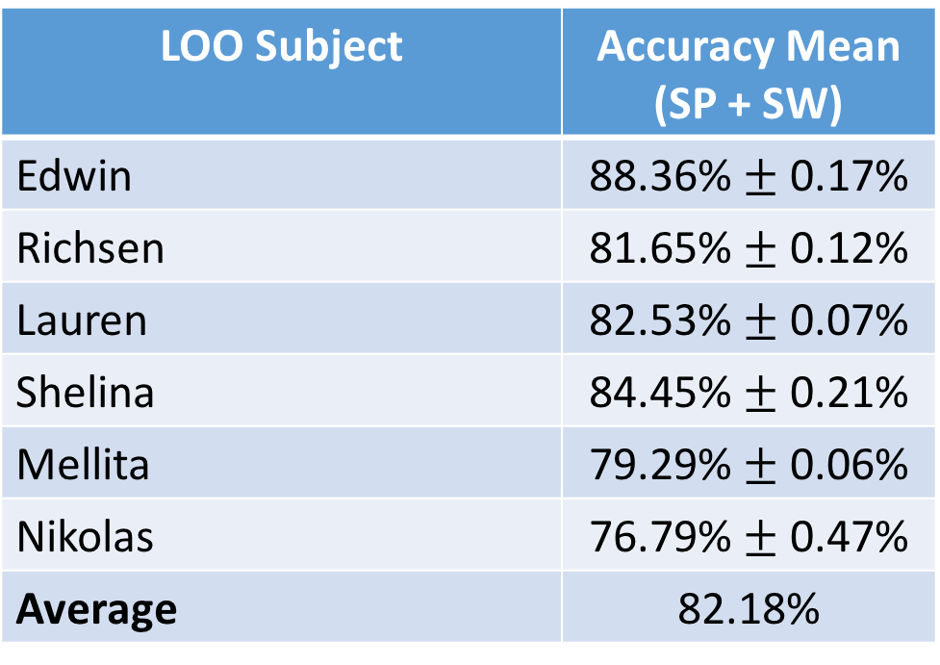
LOO (BASELINE 6 PERSONS)
14 Activities (without Eating)
Random Forest → 2000 estimators, 3 times per subject
LOO Subject | Accuracy Mean (SP + SW)
Edwin | 88.36% $±$ 0.17%
Richsen | 81.65% $±$ 0.12%
Lauren | 82.53% $±$ 0.07%
Shelina | 84.45% $±$ 0.21%
Mellita | 79.29% $±$ 0.06%
Nikolas | 76.79% $±$ 0.47%
Average | 82.18%

Slide 11
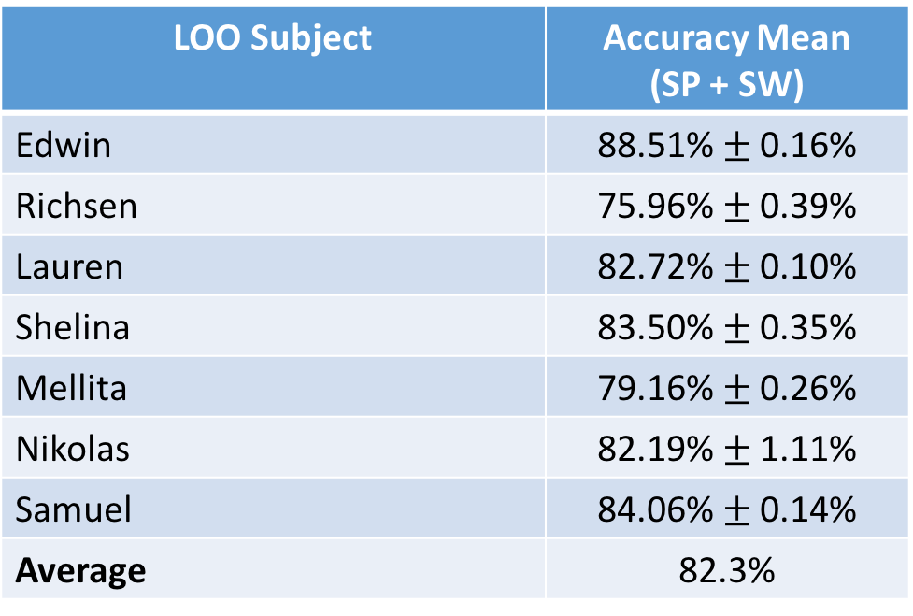
LOO (7 PERSONS)
14 Activities (without Eating)
Random Forest → 500 estimators, 3 times per subject
LOO Subject | Accuracy Mean (SP + SW)
Edwin | 88.51% $±$ 0.16%
Richsen | 75.96% $±$ 0.39%
Lauren | 82.72% $±$ 0.10%
Shelina | 83.50% $±$ 0.35%
Mellita | 79.16% $±$ 0.26%
Nikolas | 82.19% $±$ 1.11%
Samuel | 84.06% $±$ 0.14%
Average | 82.3%

Slide 12
LOO with XYZ Permutations (7 PERSONS)
14 Activities (without Eating)
Random Forest → 500 estimators, 3 times per subject
LOO Subject | Accuracy Mean (SP + SW)
Edwin | 88.51% $±$ 0.16%
Richsen | 75.96% $±$ 0.39%
Lauren | 82.72% $±$ 0.10%
Shelina | 83.50% $±$ 0.35%
Mellita | 79.16% $±$ 0.26%
Nikolas | 82.19% $±$ 1.11%
Samuel | 84.06% $±$ 0.14%
Average | 82.3%

Slide 13
LOO with XYZ Permutations (7 PERSONS)
14 Activities (without Eating)
Random Forest → result is very bad (tested on 2 subjects with different parameter values), as low as ~12% accuracy!
SVM → result is also very bad (tested on 2 subjects), < 10% accuracy
Hence, I did not do a full testing:
The results for a few test subjects are very bad
The training time is very long as the data is augmented resulting in around 6 times bigger than the usual one
This method also seems not scalable with more test subjects without using a more powerful computer to train the model!

